Slide 1

WINSTON-SALEM
AREA TPO
Planning a Safe Network
Establishing the Need for Safety Investment
Safe Streets and Roads for All (SS4A) Program
Comprehensive Safety Action Planning

Slide 2
01.
Establishing the Need for Safety Investment

Slide 3
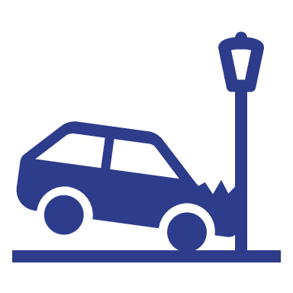



How safe our we today?
51,000
Crashes in WSATPO boundary (since 2020)
1,200
Crashes that were fatal or caused serious injury (FSI)
12%
FSI crashes that involve pedestrians
20%
FSI crashes that were speed-related
Top fatal crash locations
Crash Severity Breakdown

Slide 4
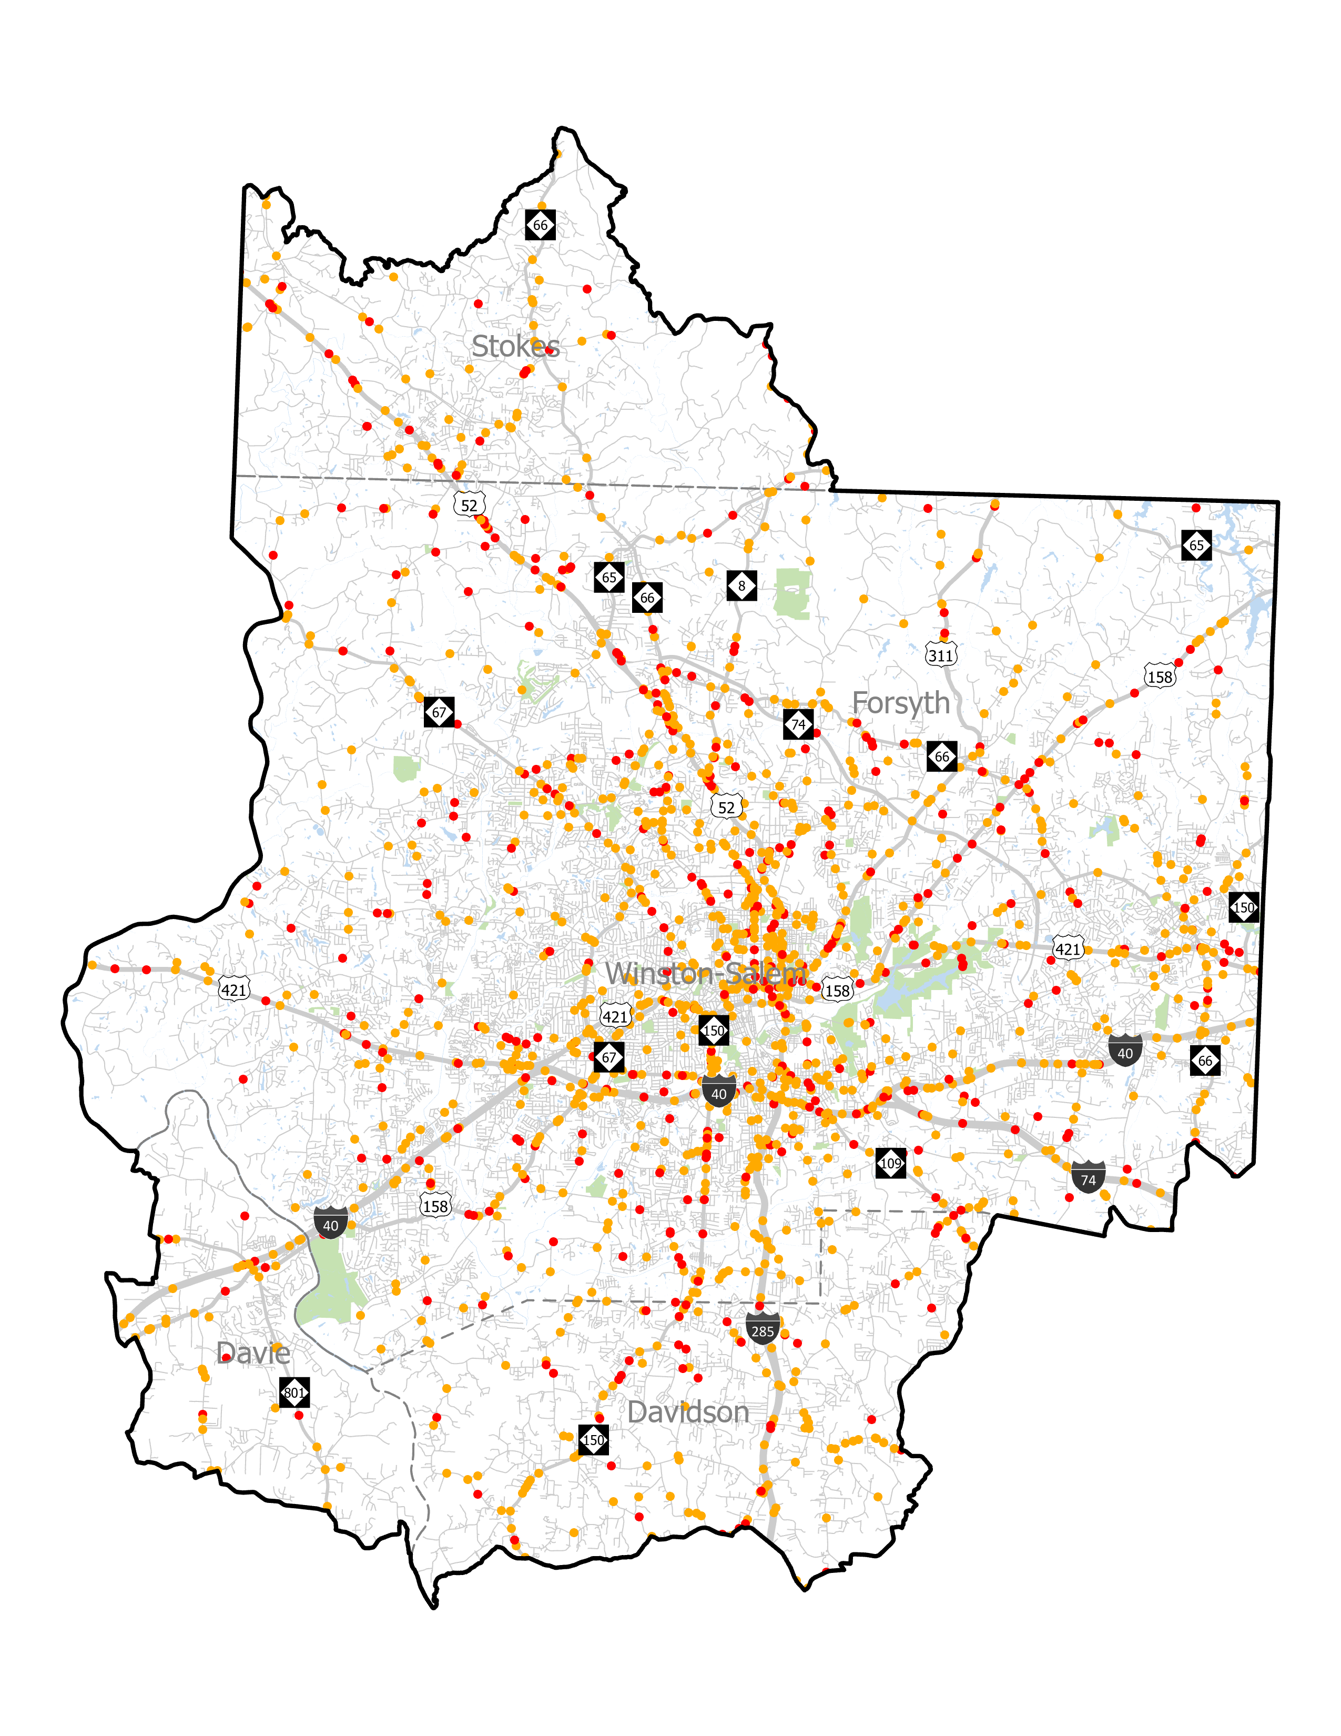
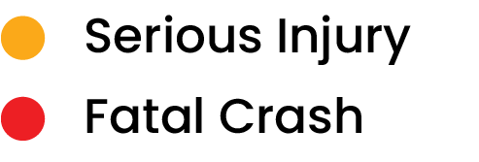
How safe are we today?
All FSI Crashes
The map to the right shows crashes from 2014 through 2023. Serious injuries and fatalities are clustered strongly in Winston-Salem and along major transportation corridors
Examples of high crash corridors in Winston-Salem include Patterson Ave, S Main St, and NC-150.
Corridors outside of Winston Salem include I-40, US-421, US-52, and US-158.

Slide 5
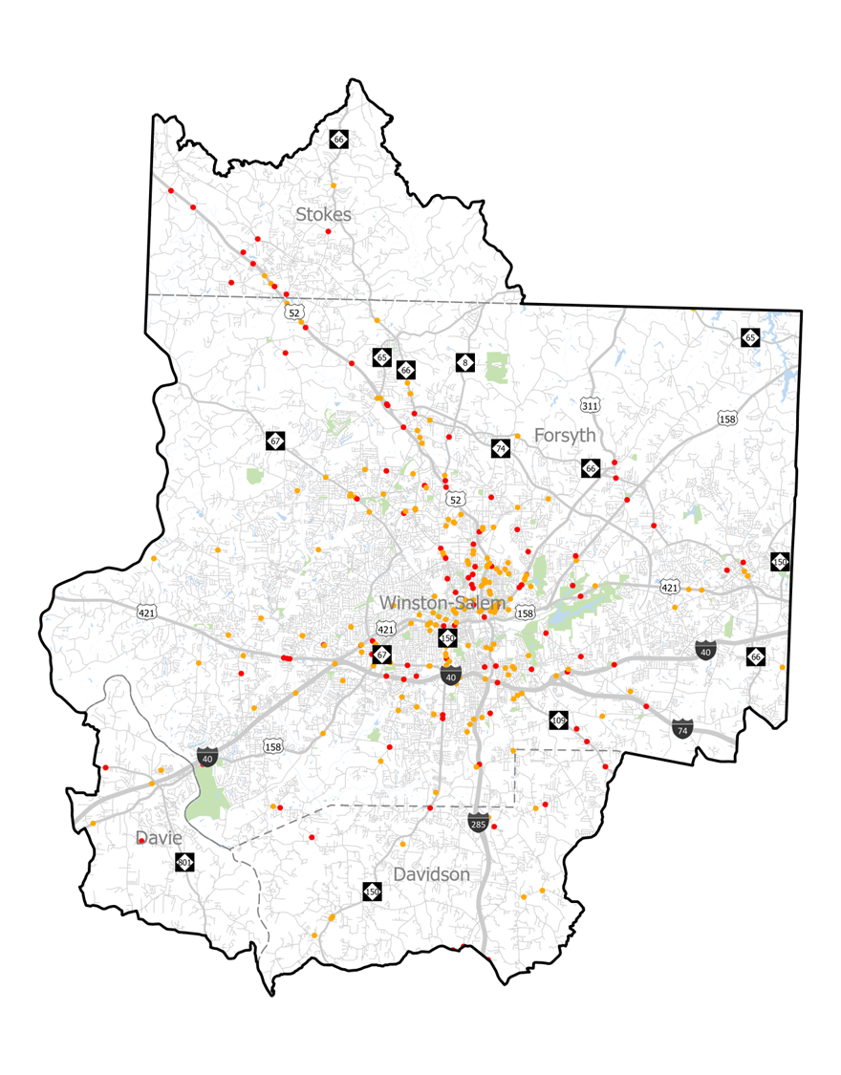
How safe are we today?
Bike/Ped FSI
This map shows crashes involving pedestrians and bicyclists from 2014 through 2023
Crashes are predominantly in Winton-Salem and on US-52. A hotspot shows up on Peter's Creek Parkway north of I-40 and in East Winston.

Slide 6



Demographic Considerations
Understanding safety needs also means understanding the needs of our community. This means we need to consider:
Diversity
Statistics show that minorities are more vulnerable on our network
Income
Not everyone can afford to own a vehicle, putting them more at risk when they’re walking/biking
Access
Access to vehicles in the household, and safe access to transportation facilities reduces risk

Slide 7
02.
SS4A and Comprehensive Safety Action Planning

Slide 8

What is SS4A?
Federal Grant Program that will award $5 BILLION from 2022-2026
Supports planning, infrastructure, and operational initiatives to MAKE OUR ROADS SAFER
(with a particular emphasis on equity)

Slide 9



What is SS4A?
Planning and Demonstration
Implementation
Safety Action Plans, supplemental planning activities, and or demonstration activities
20% match required
$100,000 to $10 million awarded
Implement projects and strategies identified in an existing safety action plan
20% match required
$2.5 to $25 million awarded

Slide 10

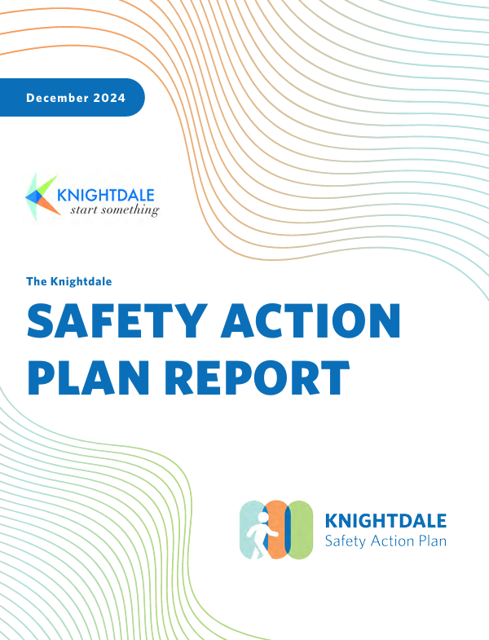
What is a Safety Action Plan (SAP)?
Provides a vision to eliminate serious injuries and death on roadways
Data-driven approach to identifying projects and strategies
Prioritizes investments in safety based on criteria that is most important to the community

Slide 11
Safety Action Plan Requirements
Formally adopted
Guided by a Task Force
Considers equity
Identifies projects
Contains an adopted safety target
Conducts public engagement
Develops a High-Injury Network (HIN)

Slide 12
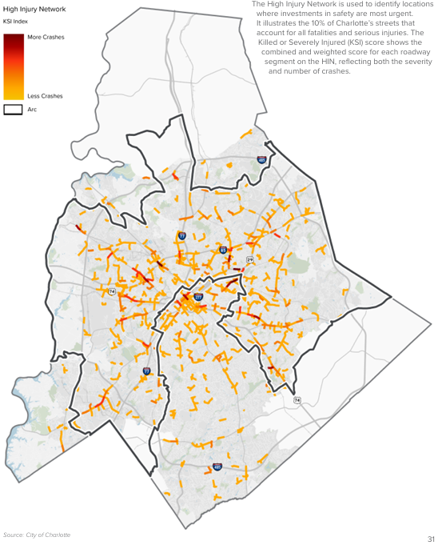
High-Injury
Network (HIN)
Quantitative process
Corridor-based depiction of highest safety needs in community
Used as a tool for prioritization
“Living” network – updated regularly

Slide 13
Key Recommendations in a SAP
Projects
Prioritization
Counter-measures
Actions
Projects that fall along identified HIN and address transportation safety issues – includes planning cost estimations
Guidance for how Waxhaw prioritizes transportation safety investment
Collection of design-focused best practices and programmatic strategies effective in improving safety
Actions and strategies that support the established shared vision – includes targets and goals

Slide 14
Making the Region Safer
A safe transportation network is a rising tide that lifts all boats
Quality of life, equity, economic development, public health
SS4A is a great way to get funding for transportation safety
Grant cycle is currently open for 2025 – current funding ends in 2026
Regional efforts already underway to improve transportation safety
Village of Clemmons is working on a plan now, and City of Winston-Salem Will be starting the process of creating a Safety Action Plan soon

